Slide 1
Boolean Functions and their Representation

Slide 2
Content:
Sum of product (SOP)
Product of sum (POS)
Standard SOP and POS Forms
Conversion of SOP to standard SOP
Conversion of POS to Standard POS
Minterms and Maxterms

Slide 3
Sum of Product
The sum-of-products (SOP) form is a method (or form) of simplifying the Boolean expressions of logic gates.
Sum and product derived from the symbolic representations of the OR and AND functions.
OR (+) , AND ( . ) , addition and multiplication.
Sum
f(A,B,C) = ABC + A’BC’
Product terms

Slide 4
Product of Sum
When two or more sum terms are multiplied by a Boolean OR operation.
Sum terms are defined by using OR operation and the product term is defined by using AND operation.
Product
f(A,B,C) = (A’+B) . (B+C’)
Sum terms

Slide 5
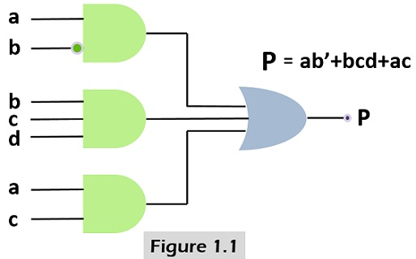
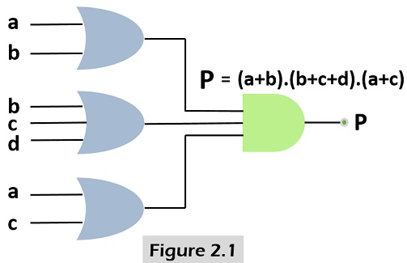
Examples
Example 1
f(a,b,c,d)=a.b’+ b.c.d + a.c
is an expression in SOP.
Example 2
f(a,b,c,d)=(a+b).(b+c+d).(a+c)
is an expression in POS.

Slide 6
Standard SOP and POS Forms
The canonical forms are the special cases of SOP and POS forms.
These are also known as standard SOP and POS forms.

Slide 7
Canonical Form
In SOP or POS form, all individual terms do not involve all literals.
For example AB + A’BC the first product term do not contain literal C.
If each term in SOP or POS contain all literals then the expression is known as standard or canonical form.

Slide 8
Canonical Form
Each individual term in the POS form is called Maxterm.
Each individual term in the SOP form is called Minterm.
In Minterm, we look for the functions where the output results is “1”.
while in Maxterm we look for function where the output results is “0”.
We perform Sum of minterm also known as Sum of products (SOP) .
We perform Product of Maxterm also known as Product of sum (POS).

Slide 9
Conversion of SOP to standard SOP form
Step 1: Find the missing literal in each product term if any.
Step 2: And each product term having missing literals with terms form by ORing the literal and its complement.
Step 3: Expends the term by applying, distributive law and reorder the literals.
Step 4: Reduce the repeated product terms. Because A + A = A (Theorem 1a ).

Slide 10
Example: 1
f (A,B,C) = AB + BC + AC
Step 1: Find the missing literals in each product term.
f (A,B,C) = AB + BC + AC
Literal B is missing
Literal A is missing
Literal C is missing
Step 2: AND the product term with missing literal + its complement.
f (A,B,C) = AB . (C+C’) + BC . (A+A’) + AC . (B+B’)
Missing literals and their complements

Slide 11
Step 3: Expends the term and reorder the literals. f (A,B,C) = AB . (C+C’) + BC . (A+A’) + AC . (B+B’)
Expand & Reorder:
ABC + ABC’ + ABC + A’BC + ABC + AB’C
Step 4: Omit repeated product terms.
f(A,B,C)=ABC + ABC’ + ABC + A’BC + ABC + AB’C f(A,B,C)= ABC + ABC’ + A’BC + AB’C

Slide 12
Conversion of POS to standard POS form
Step 1: Find the missing literal in each sum term if any.
Step 2: OR each sum term having missing literals with terms form by ANDing the literal and its complement.
Step 3: Expends the term by applying, distributive law and reorder the literals.
Step 4: Reduce the repeated product terms. Because A + A = A (Theorem 1a ).

Slide 13
Step 1: Find the missing literals in each sum term.
Example: 2
f (A,B,C) = (A + B) . (B + C) . (A + C)
f (A,B,C) = (A + B) . (B + C) . (A + C)
Literal B is missing Literal A is missing Literal C is missing
Step 2: OR the sum term with missing literal . its complement.
f (A,B,C) = (A + B)+(C.C’) + (B + C)+(A.A’) + (A + C)+(B.B’)
Missing literals and their complements

Slide 14
Step 3: Expends the term and reorder the literals.
f (A,B,C) = (A + B)+(C.C’) + (B + C)+(A.A’) + (A +C)+(B.B’)
Expand & Reorder:
f(A,B,C)=(A+B+C).(A+B+C’).(A+B+C).(A’+B+C).(A+B+C).(A+B’+C)
Step 4: Omit repeated sum terms.
f(A,B,C)=(A+B+C).(A+B+C’).(A+B+C).(A’+B+C).(A+B+C).(A+B’+C)
f(A,B,C)=(A+B+C).(A+B+C’).(A’+B+C).(A+B’+C)

Slide 15
Conversion of SOP from standard to canonical form
Example: 3
Expand non-canonical terms by inserting equivalent of 1 in each missing variable x: (x + x’) = 1
Remove duplicate minterms
f₁(a,b,c) = a’b’c + bc’ + ac’ = a’b’c + (a+a’)bc’ + a(b+b’)c’ = a’b’c + abc’ + a’bc’ + abc’ + ab’c’ = a’b’c + abc’ + a’bc + ab’c’
= 001 + 110+011+100

Slide 16
Conversion of POS from standard to canonical form examples
Example 4
Expand noncanonical terms by adding 0 in terms of missing variables (e.g., xx’ = 0) and using the distributive law
Remove duplicate maxterms
f₁(a,b,c) = (a+b+c)•(b’+c’)•(a’+c’) = (a+b+c)•(aa’+b’+c’)•(a’+bb’+c’) = (a+b+c)•(a+b’+c’)•(a’+b’+c’)• (a’+b+c’)•(a’+b’+c’) = (a+b+c)•(a+b’+c’)•(a’+b’+c’)•(a’+b+c’)

Slide 17
Activity 1
Express the following functions in canonical forms
f1=a.b’.c+b.c’+a.c
f2=(a+b).(b+c’)
Solutions:
a)f1=a.b’.c+b.c’+a.c=
=a.b’.c+(a+a’).b.c’+a.(b+b’).c=
=a.b’.c+a. b.c’ +a’.b.c’+a.b.c+a.b’.c
b)f2= (a+b)(b+c’)=
= (a+b+c.c’)(a.a’+b+c’)=
= (a+b+c).(a+b+c’).(a+b+c’).(a’+b+c’)=
= (a+b+c).(a+b+c’).(a’+b+c’)
f1 is expressed in DCF,
f2 is expressed in CCF.

Slide 18
Activity 2
Which of the following is an incorrect SOP expression? a) x+x.y b) (x+y)(x+z) c) x d) x+y

Slide 19
Contd..
Convert to canonical SOP function F = x y + x z + y z
Convert to canonical POS form
F = (A’ + B + C) * (B’ + C + D’) * (A + B’ + C’ + D)

Slide 20
Thank You

